Slide 1
Capstone Used Car Prices Final Project
Rahul Mody, Kelsey Luo

Slide 2
Agenda
3 | Executive Summary
4 | Business Problem Overview & Solution Design
5 | Data Preprocessing
6 | Exploratory Data Analysis
9 | Model Performance Summary
10 | Random Forest
11 | Business Impact
12 | Q&A

Slide 3
Executive Summary
Context
Insights
The pre-owned car market in India is growing larger than the new car market
Issue lies in that pre-owned cars are difficult to price. Lots of variables at play to determine the value of a used car
Starting price, engine, power, number of seats, mileage per gallon, mileage, brand
Important to solve in order to properly price the used car. Without a pricing model, you may end up undervaluing the car and leaving money on the table.
Used random forest regression to predict the price of a used car, given all its features
We have identified the features with the most relative importance; Cars4U can focus on these
Marketing efforts
Set prices based on data, to increase profitability and sales
Decrease for sales or increase for more gains
If a car is not selling, use this pricing tool to gauge why demand is low

Slide 4



Business Problem Overview & Solution Approach
01
The Problem
Struggling to price used cars given a list of features
Need to determine the key variables that predict the price of a used car
How can we use this to our advantage?
02
Approach
Obtain a dataset regarding used cars, its features, and its selling price
Perform exploratory analysis to determine which features correlate well with selling price
Split data into training and testing data
Perform different forms of regression & determine which one is the best fit
03
Methodology
Use of linear regression, ridge regression, decision trees, and random forests
Leverage R squared and Root Mean Squared of Error to determine predictive performance
Hypertuned parameters to further our research and yield more enticing results

Slide 5
Data Pre-Processing
We want to clean the data so that it is ready for regression without any issues
Pre-processing Steps | Description | Why it was needed
Removed Unnecessities | Dropped the Serial Number column, and removed a row with data that is clearly false | To make the data clean and reliable
Added Brand column | Replaced the Name column with Brand, which is just the brand of the name column | Because there are too many unique values using the Name column. We are now able to group using just the 33 brands we have.
Feature Engineering | Mileage, engine, power, and seats all had some null values so we replaced them with the median of each, grouped by Brand | Data will not read with null values. Replacing with the median is a safe bet.
Feature Engineering | Mileage had 0 for some data, so we replaced them with the median of each, grouped by Brand | It does not make sense for a car’s mileage to be 0, so it must have meant to be null. In that case, we must do feature engineering
Dummy Variables | Creating dummy variables for the categorical features, such as Brand and Fuel Type. Created columns with 1’s and 0’s | Categorical features would not be accounted for in regression techniques if they are not in numerical form. Dummy variables helps solve this issue
Dropping Price | Drop any rows where the price is not known. | Without knowing the price, the training data cannot accomplish anything as that is the dependent variable

Slide 6
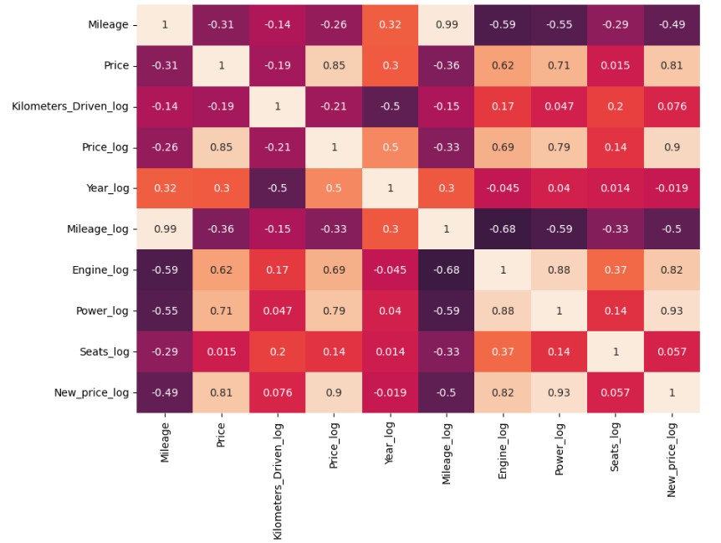
Exploratory Analysis Results - Numerical
Observations
Power (0.79), engine (0.69), and new price (0.9) have a strong correlation with Price
Mileage (-0.33), KM Driven (-0.21), and seats (0.14) have a weak correlation with Price
Note: Leveraged the use of logs to normalize the values across

Slide 7
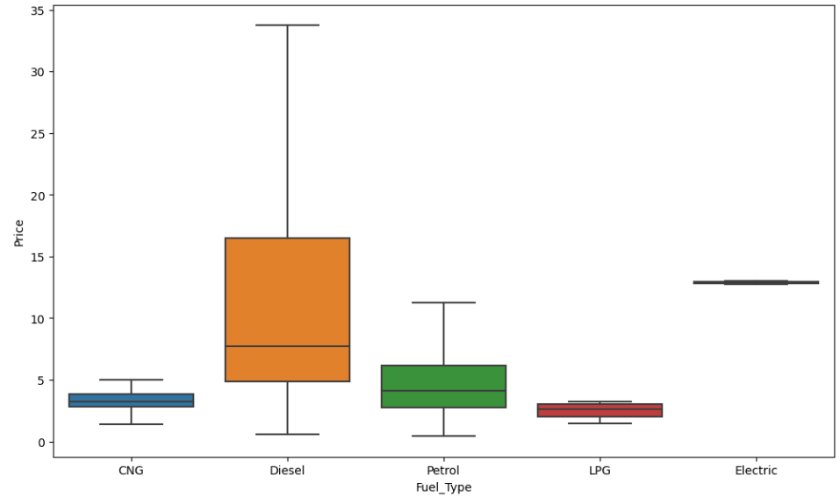
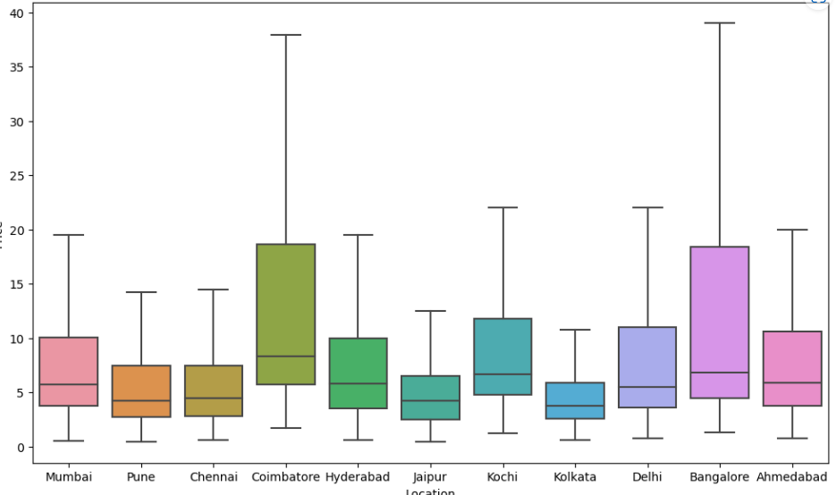
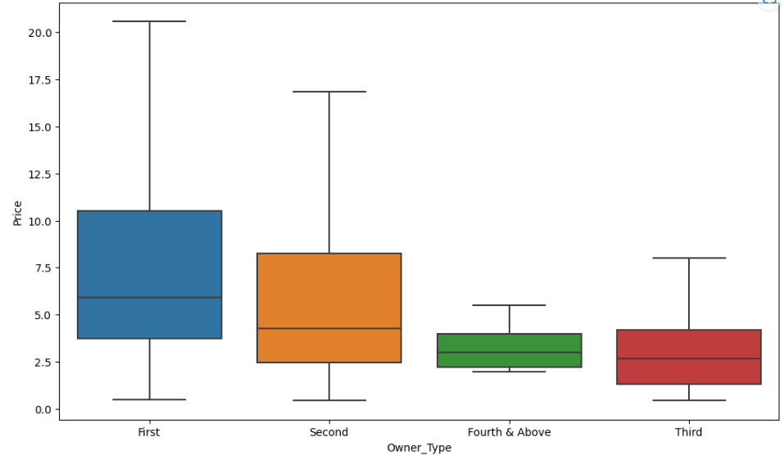
Exploratory Analysis Results - Categorical
Automatic cars have a higher median price than manual
Generally, cars owned by less people have higher median prices
Diesel cars have a higher median price
Location has slight differences in median price
Differential pricing among various car brands and locations
These factors could be compounded with other features as well

Slide 8
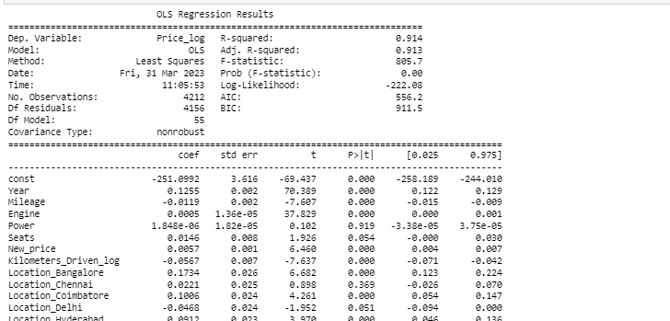
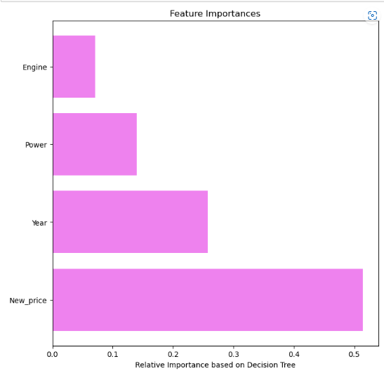
Linear Regression - Insights
Important Variables
Refined Insights
Year has a higher importance than initially thought
Newer cars are priced higher.
Power has a key importance to Price, but its P-value was very high using linear regression
Sign of multicollinearity
Able to drop many features during Linear regression
Dropped seats and some brands

Slide 9
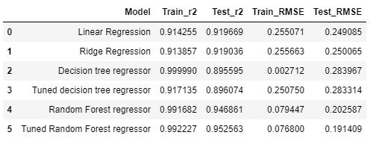
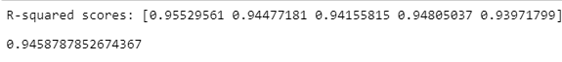
Different Techniques
The R squared value reflects the fit of the model, scale from 0 to 1. All of them seem like strong fits
Minimal Root Mean Squared error
Random forest generates the best performance, based on training and testing data
Cross validation yields strong results as well

Slide 10
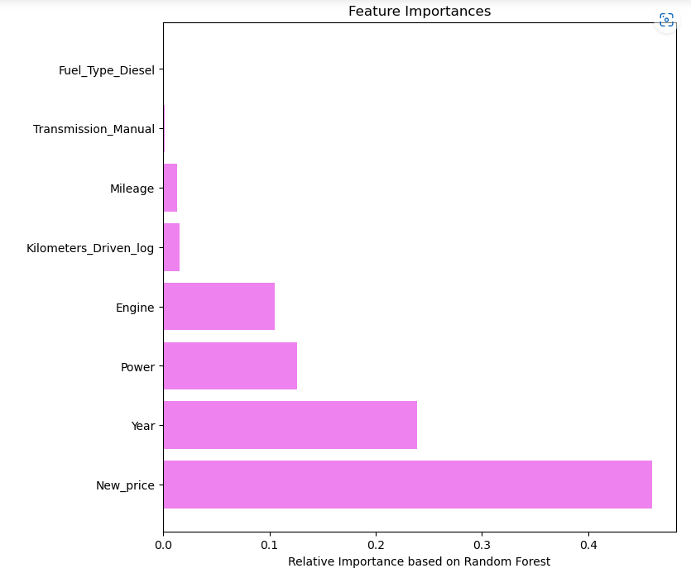
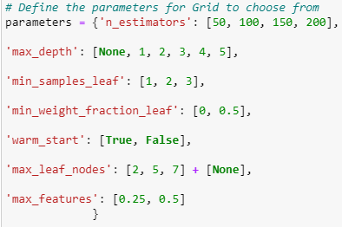
Random Forest with Tuned Hyperparameters
200 Decision trees used
No max depth, no minimum number of samples for a leaf node
Maximum features in a decision is 0.5
No sign of overfitting, due to original random forest strength
New price, year, engine, and power
Strong performance regardless of which features we use

Slide 11
Impact of Model Findings
01
So what?
We can now use the random forest model to determine the price of a used car
Some features are more important than others, but the model does not rely on one particular feature
Can apply analysis with missing features, with still roughly a strong performance
Low chance of overfitting
02
Moving Forward
Based on data, we can increase price for profits or decrease to increase demand
Risk: Must be careful in which data this works for; would only work for data relevant to the same year. Worth a 3rd dataset to look at
The data could be better suited in a non-linear relationship, which has not been captured in these models
Deeper dive into feature importance, and what variables may be more important to look into

Slide 12
Thank you!

